Slide 1

Hi Pitch Ios Mobile Version
Style guide

Slide 2
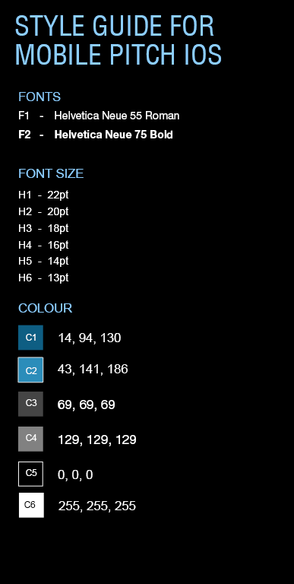
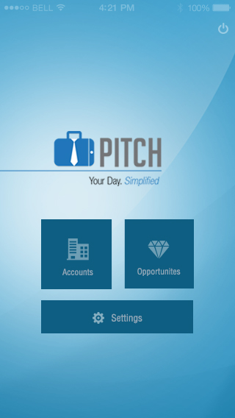
Box style
W95 x H95px, C1
20px padding
Box style
W210 x H45px, C1
Font Style
F1, H6, C6(60% Transparent)

Slide 3
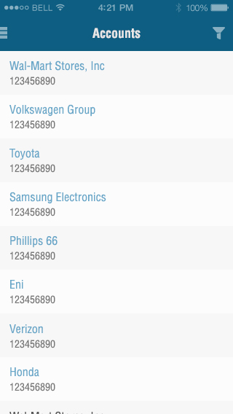
List Grid Style
H60px
Color: 247, 247, 247
List Grid Style
H60px
Color: 252, 252, 252
Header Size
H50px, C1
Font Style
F2, H3, C6
Font Style
F1, H4, C2
Font Style
F1, H5, C4

Slide 4
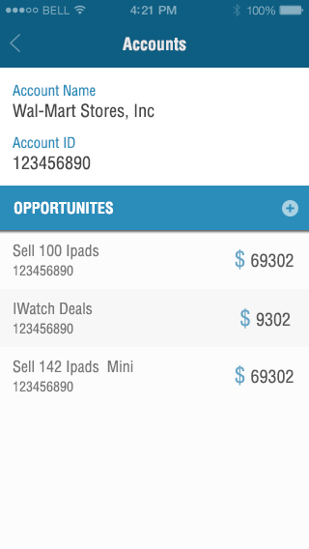
10px padding
Height 45px, C2

Slide 5
Font Style
F2, H5, C2
Font Style
F1, H4, C3
Font Style
F1, H3, C6
Font Style
F1, H4, C3
Font Style
F1, H5, C4

Slide 6
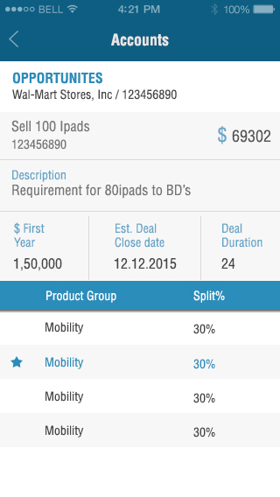
Font Style
F1, H5, C5
Font Style
F2, H4, C2
Font Style
F1, H5, C4
Font Style
F1, H5, C3
Font Style
F1, H5, C3
Font Style
F1, H5, C2
Font Style
F1, H4, C6
Font Style
F1, H5, C2
Font Style
F1, H5, C3

Slide 7
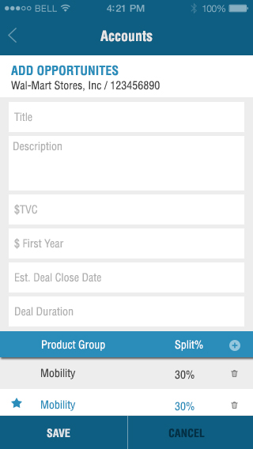
10px padding on all sizes
Box Style
Height: 85px, C6
Font Style
F1, H5, C4
Box Style
Height: 50px, C6

Slide 8
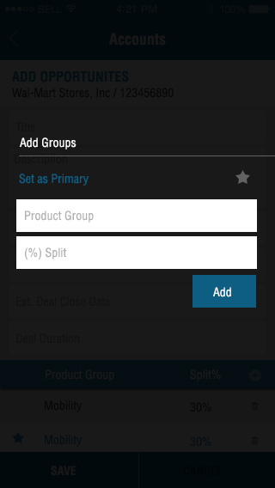
BG Style
C5 (80% Transparent)
Font Style
F2, H5, C6
Font Style
F1, H5, C2

Slide 9
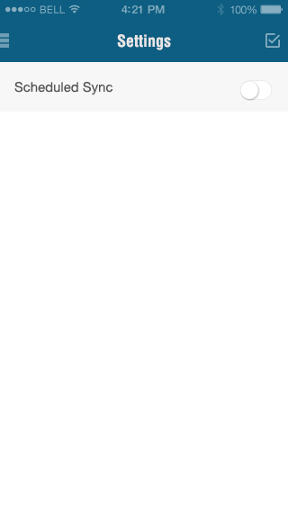
Font Style
F1, H4, C3
H60px
Color: 247, 247, 247

Slide 10
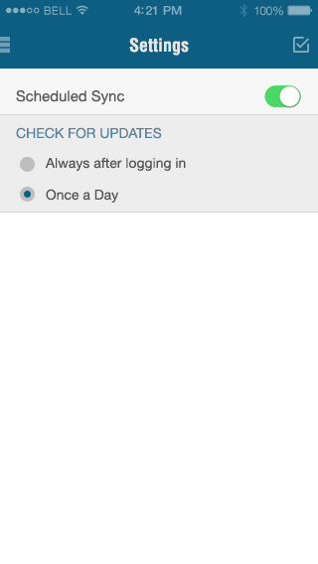
Font Style
F2, H5, C1
Font Style
F1, H5, C3

Slide 11
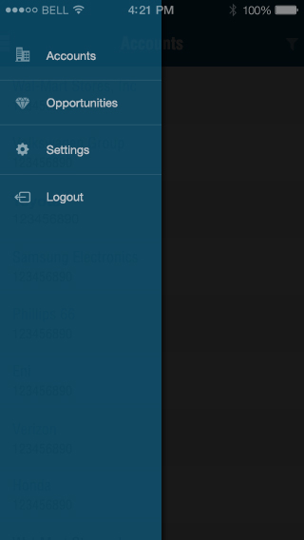
Font Style
F1, H5, C6 (80% Transparent)
H45px
Line Style
1px, C6 (20% Transparent)
Box Style
W-180px, C1 (80% Transparent)
Little Dropshadow
C5 (80% Transparent)

